Slide 1

FACE DETECTION
MINI PROJECT PRESENTATION

Slide 2

Mini Project Report on
FACE DETECTION
Submitted in partial fulfilment of the requirement for the award of the degree of
BACHELOR OF TECHNOLOGY
IN
COMPUTER SCIENCE & ENGINEERING
Submitted by:
Name- EKANSH TYAGI Uni. Roll No- 2016743
Under the Mentorship of
Mr. SAURABH KUMAR MISHRA
Assistant Professor
Department of Computer Science and Engineering
Graphic Era (Deemed to be University)
Dehradun, Uttarakhand
January 2023

Slide 3

AGENDA
What is Face Detection?
Methodology
Result and Discussion
Conclusion of the Project
Applications

Slide 4

What is Face Detection?
Face detection also known as Facial Detection is a computer technology that uses Artificial Intelligence (AI) to find and recognize human faces in digital photographs. Face Detection technology can be used to enable real-time surveillance and tracking of people in a variety of industries, such as SECURITY, BIOMETRICS, LAW ENFORCEMENT,ENTERTAINMENT and PERSONAL SAFETY.
From basic computer vision methods to developments in machine learning (ML) to increasingly complex artificial neural networks(ANN) and related technologies, face detection has advanced, ongoing and leading performance. It now serves as the foundation for a number of crucial applications such as Face Tracking, Face Analysis, and Facial Recognition. The application’s ability to perform sequential tasks has a substantial impact on face detection.

Slide 5
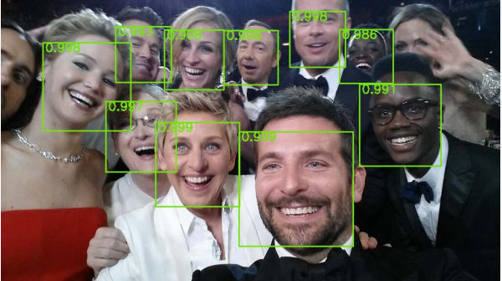
The algorithm which is the basis of the face detection project is the HAAR CASCADE ALGORITHM or VIOLA-JONES FACE DETECTION SYSTEM. This algorithm can be used to detect faces inside a photograph or a video. This consists of various data sets which are used to detect various body parts of a human inside a photo or a video. The various datasets of the HAAR CASCADE ALGORITHM can be found easily over the internet (most commonly over GitHub). It is a part of the openCV library.
The algorithm and code for Face Detection are very easy to understand and implement. And as described before, Face Detection acts as a basis for various other projects like Facial recognition, Face Analysis etc.

Slide 6
Methodology
This project is developed on GOOGLE COLAB IDE.
First step is as always including the libraries. The three libraries used for this project are:-
OpenCV- This library allows us to perform image processing and computer vision tasks.
NumPy- It is a library for the python language which adds support for large, multi-dimensional arrays and matrices, along with a large collection of high-level mathematical functions to operate on these arrays.
MatPlotLib- Python library to create low level graphs
The algorithm which is the basis of this project is known as the HAAR CASCADES ALGORITHM. Also known as the Viola-Jones Face Detection Technique, this algorithm was discovered long before deep learning came into popularity. This algorithms is still found to be used almost everywhere. Its fully trained models are available on OpenCV GitHub Repository.
“Basically, This algorithm is an Object Detection Algorithms used to identify faces in an image or a real time video. The edge or line detection characteristics that Viola and Jones suggested in their 2001 study “Rapid Object Detection using a Boosted Cascade of Simple Features” are used by the technique. To train the algorithm, it is given a large number of positive images with faces and a large number of negative images without any faces.”
In the next step, a Cascade Classifier object will be created. The path to the classifier file is sent as an argument to the function object () of this class. We will apply the classifier file haarcascade_frontalface_default.xml in this case (A data set from the OpenCV library to detect the facial features inside a photograph or a video). I have used the entire file path to ensure that the file is accessed properly.

Slide 7
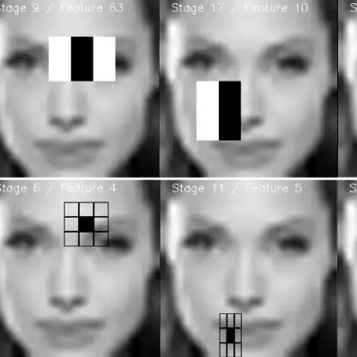
Now, the imread function of the cv2 module will then be used to load the picture. The path to the picture will be provided as input to this function. We will use the image we wish to use for face detection as our input.
In order to apply the classification, the image will be converted to grayscale. We use the CvtColor funvtion to do this. This will take the original image as input and the code for the colour space conversion as the second input. In this instance, we utilize the COLOR BGR2GRAY function to convert RGB to Grey.
Now we will use the detetctMultiscale method on our face cascade object to perform the real face detection. We will provide our transformed grayscale image as input. Additionally, various tuning options may be sent to this method, such as scaleFactor or the object to detect minimum size. For the sake of simplicity, I will just pass the image as input.
The identified items will be returned by their functions as rectangles, so we an easily mark them in the output image.

Slide 8
The faces in our initial image will have rectangles around them when we iterate the findings.. Calling the rectangle method on the cv2 Module does this. The picture, the beginning and final vertexes of the rectangle, the RGB colour of the rectangle, and the thickness of the rectangle are all inputs for this function. In order to find and draw all the rectangles, we will accomplish this within a for in loop.
Additionally, we display the number of faces in our image in the lower left corner. Given that we are unsure of the colour of the photos, we will first construct another rectangle to place the text on top of.
The starting vertex will be at coordinates (x = 0, y = image height – 25) and the end vertex will be at (x = 270, image height). To avoid more complex code, this is hardcoded for the size of the text we will specify.
Keeping in mind that we can use the same approach we used with the ndarray before to get the image’s height. We use the shape approach to get the number of rows because the image is a matrix.
We will instruct the rectangle function to fill the rectangle by passing it the color white and the thickness -1. The bottom left corner of the picture, the text, the font, the scale of the text, the colour, and the thickness are passed as input to the putText function when writing the text.
Finally, we show the edited image with rectangles and the text.

Slide 9
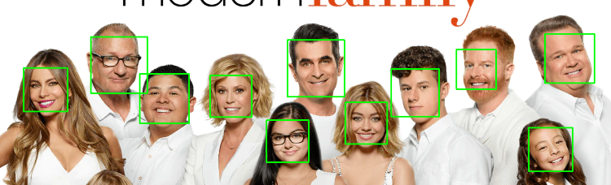
RESULT AND DISCUSSION
The detected faces are displayed with a rectangle around them and the number of faces are displayed with the help of another rectangle.
This program does not give 100% accurate results. Sometimes it can give random rectangles at places where there is no face. I have checked this by performing face detection on multiple images. Sometimes it also doesn’t identify a face.
Although, the accuracy can be increased by making subtle changes into the dataset or scalefactor and minNeighbour values.

Slide 10

CONCLUSION
In this project, I have made a fast and highly accurate face detection application. We also learnt about the HAAR CASCADES algorithm through this project. This algo acts as the basis for Face Detection and its various applications. The many training models of this algorithm can be accessed through OpenCV github repository.
We also learnt about various cv2 functions within pyhton and also learnt to handle various errors in our code. We also perfected our skills to learn Google Colab IDE. Other IDEs which can be used to perform this project are PyCharm, Jupyter Notebook or Kaggle etc.
The main job within this project is of the haarcascade_frontalface_default.xml training model. This model stores the default features of a human face and is used to detect them within a photo or a video. This model was downloaded from GitHub.
Through this project we also learnt about three python libraries namely, OpenCV, matplotlib and NumPy and their various features.

Slide 11
APPLICATIONS
This project can have various types of usage in the future: -
Improved Security- Face detection improves surveillance efforts and helps track down criminals and terrorists. Personal security is also enhanced since there is nothing for hackers to steal or change, such as passwords.
Easy to Integrate- Face detection is easy to integrate, and most solutions are compatible with most of the security software.
Automated Identification- In the past, identification was manually performed by a person; this was inefficient and frequently inaccurate. Face detection allows the identification process to be automated, thus saving time and increasing accuracy.

Slide 12

THANK YOU

